Slide 1

The Dark Matter
Ali ÖVGÜN

Slide 2
Sections
1. Dark Matter and WIMPs
(now)
2. f(R) Gravity and its relation to the interaction between DE and DM
(next time)

Slide 3
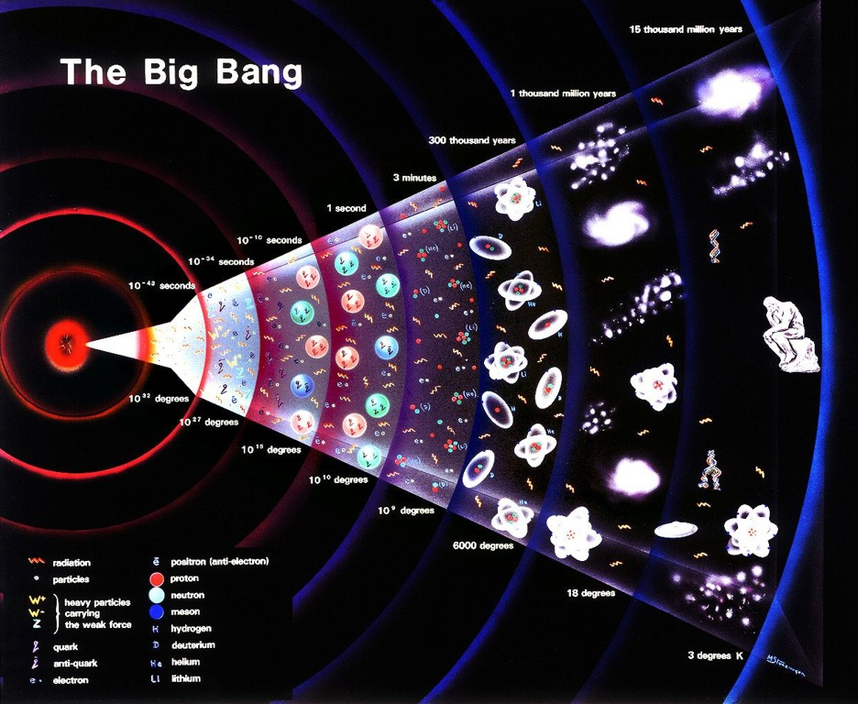

Slide 4
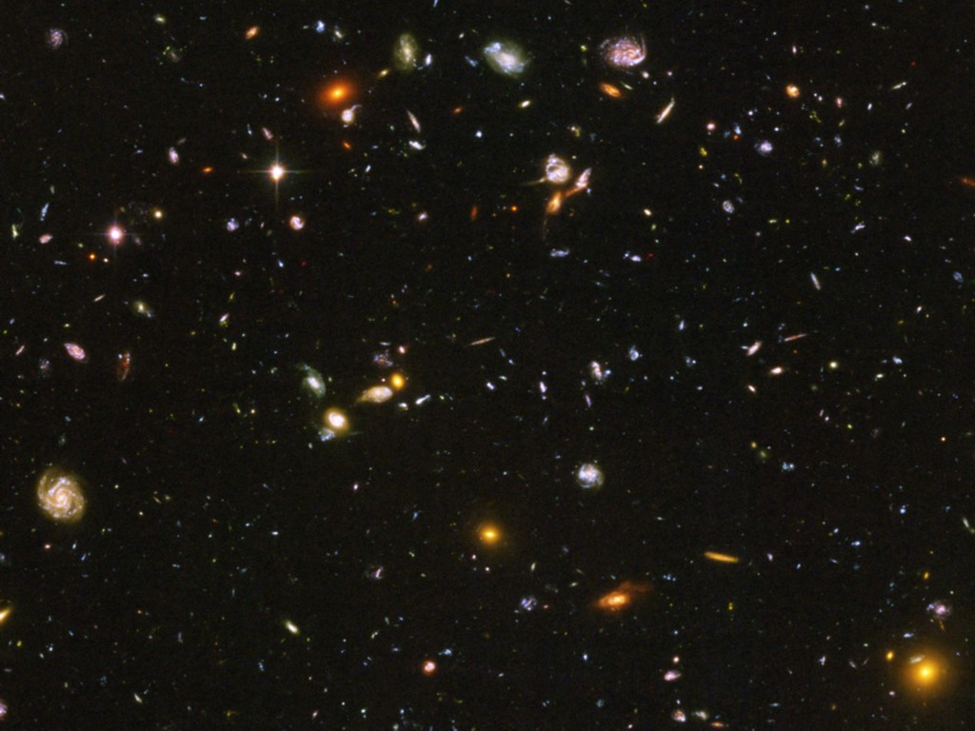
Title
Dark Energy 73%
(Cosmological Constant)
Neutrinos
0.1−2%
Ordinary Matter 4%
(of this only about
10% luminous)
Dark Matter
23%

Slide 5
Mass and Gravity
All mass has gravity.
Gravity attracts all things with mass.
Kepler’s Third Law tells us how mass moves due to gravity.
Use Kepler’s Third Law to find out how much mass is where.

Slide 6
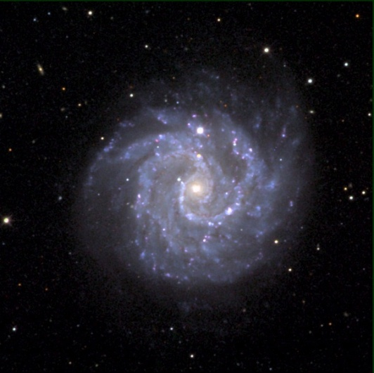
Mass and Luminosity
Most mass gives off light.
Amount of light tells how much mass is present.
Where there’s more light, there is more mass.
More light from galaxy centers vs. edges.
Conclude more mass in center vs. edges.

Slide 7
Dark Matter
Look at:
Our galaxy.
Other galaxies.
Pairs of galaxies.
Clusters of galaxies.
Mass due to gravity.
Mass indicated by luminosity.
Same?
No! → Dark Matter.

Slide 8
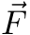
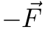
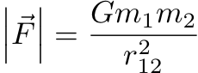
Evidence for Dark Matter
Use the fact that massive objects, even if they emit no light,
exert gravitational forces on other massive objects.
m₁
r₁₂
m₂
Study the motions (dynamics) of visible objects like stars
in galaxies, and look for effects that are not explicable by
the mass of the other light emmitting or absorbing objects
around them.

Slide 9
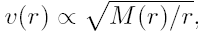
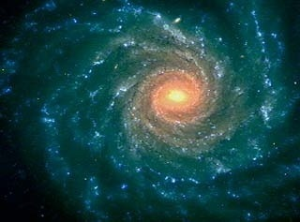
Sun’s Rotation Speed Around Milky Way
In the milky way, all stars rotates around the center of the galaxy
According to Newton’s gravitational theory，the rotation speed of the sun depends on the mass distribution and the distance to the center
According to this formula, the
Rotation speed of the sun
Shall be around 170km/s, however
The actual speed is about 220
-250km/s.
r
v(r)

Slide 10
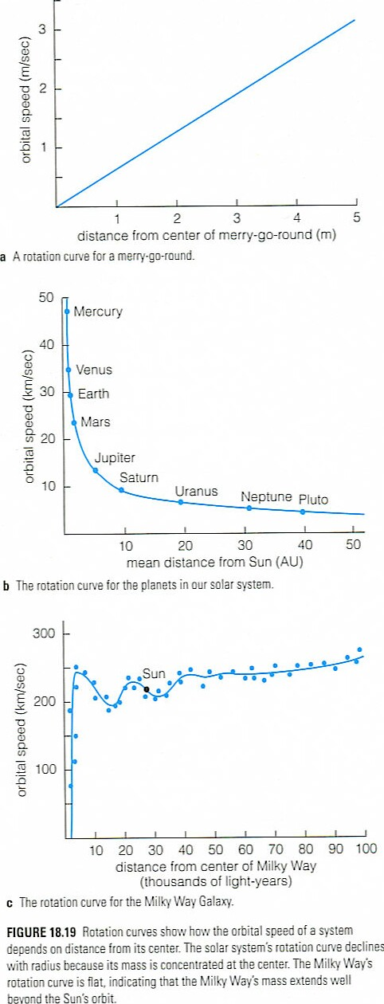
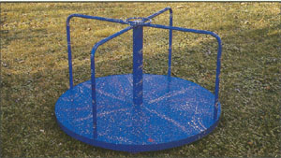
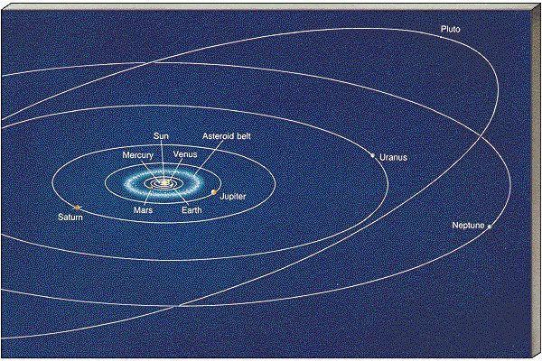
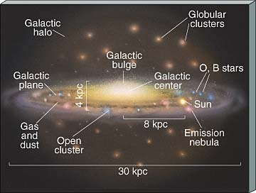
Examples of Rotation Curves

Slide 11
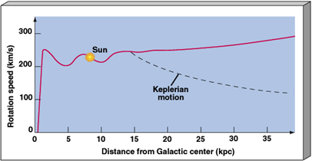
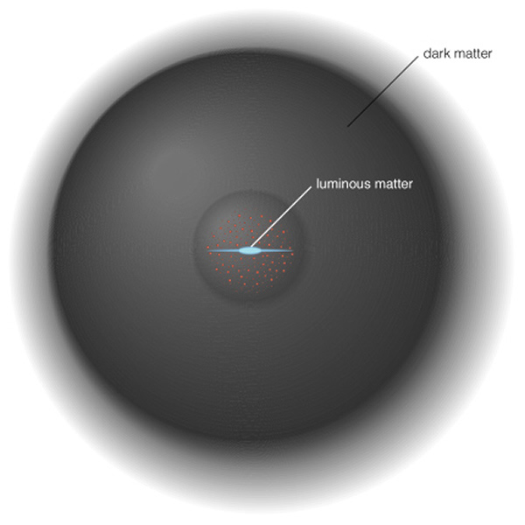
What do we see?
From variable stars we know distances.
From Doppler shift we know rotation velocity.
Edges of Milky Way go too fast.
Must be extra mass near edges of galaxy.

Slide 12
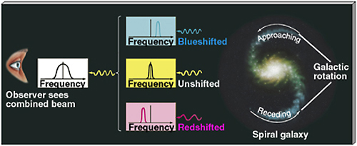
Rotation Curves
If HI gas is rotating or moving, the 21cm radiation will be Doppler Shifted.

Slide 13
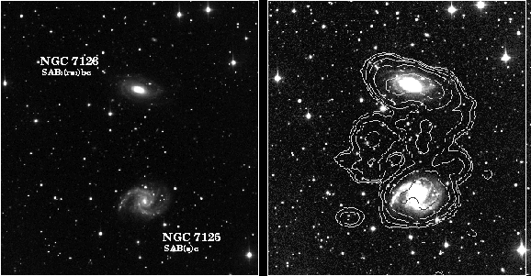
More Galaxy Masses
Apply Kepler’s Laws to galaxy pairs.
Get mass due to gravity.
Look at total light from both galaxies.
Estimate mass from luminous objects.

Slide 14
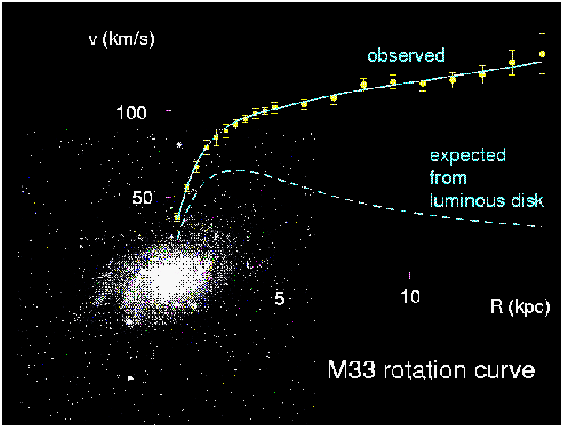
Evidences — galaxy scale
From the Kepler’s law, for r much larger than the luminous terms, you should have v∝r^{-1/2} However, it is flat or rises slightly.
The most direct evidence of the existence of dark matter.
Corbelli & Salucci (2000); Bergstrom (2000)

Slide 15
Here’s one simple way to mass a galaxy
Mass of galaxy = number of stars x average mass of star
It turns out that galaxies do not have enough visible mass to stay grouped in clusters. The extra mass they need must come from dark matter.

Slide 16
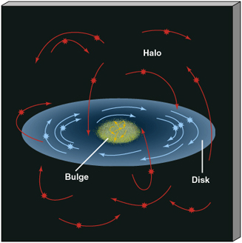
Galaxy Rotation
Objects in the disk, orbit in the disk.
Kepler’s Third Law gives the total mass in orbits.
Basically, it states that the square of the time of one orbital period (T²) is equal to the cube of its average orbital radius (R³). (1 AU = 150,000,000 km)

Slide 17
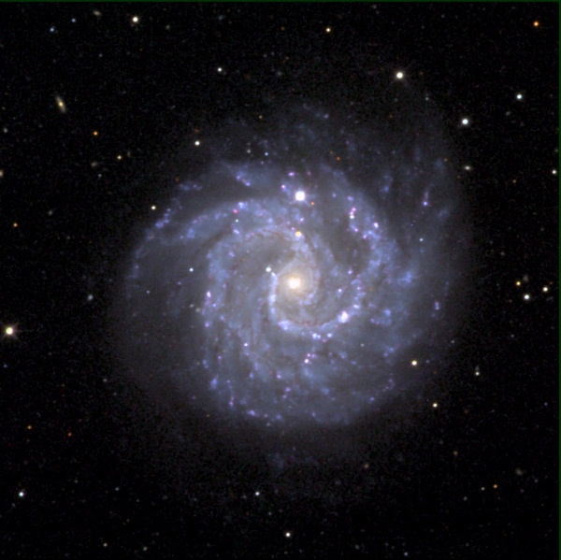
Distributed Mass
In Kepler’s Law, the total mass is the mass “inside” the orbit.

Slide 18
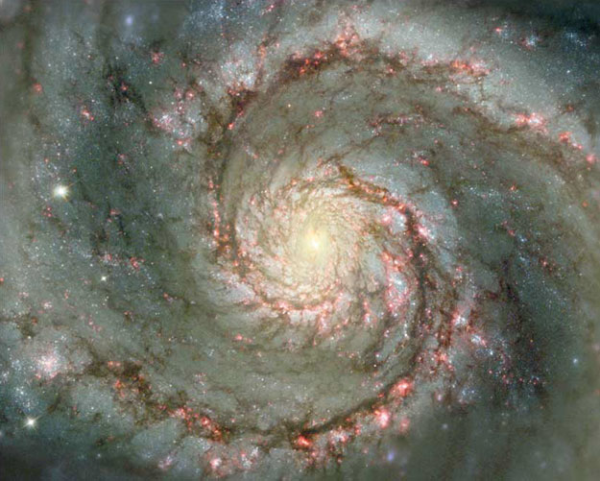
What should we expect?
Solar System:
Planet | Separation (AU) | Velocity (km/s)
Mercury | 0.5 | 48
Earth | 1 | 30
Saturn | 10 | 10
Pluto | 40 | 5
+
V
D

Slide 19
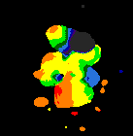
M/L ~ 20 – 130!

Slide 20
Even More Galaxy Masses
Look for gravitational lenses near galaxy clusters.
More lensing means more mass.
Compare mass from lensing to luminosity.

Slide 21
Dark Matter content in a galaxy
This implies the existence of a dark halo, with mass density
ρ(r) ∝ 1/r², i.e., M(r) ∝ r;
At some point ρ will have to fall off faster (in order to keep the total mass of the galaxy finite), but we do not know at what radius this will happen.
This leads to a lower bound on the DM mass density,
Ω_{DM}>∼0.1,
where Ω_{X} ≡ ρX/ρcrit, ρcrit being the critical mass
density to be described later (i.e., Ωtot = 1)

Slide 22
Local Dark Matter Density
The DM density in the “neighborhood” of our solar system was first estimated as early as 1922 by J.H. Jeans, who analyzed the motion of nearby stars transverse to the galactic plane. He concluded that in our galactic neighborhood, the average density of DM must be roughly equal to that of luminous matter (stars, gas, dust).
Remarkably enough, the most recent estimates, based on a detailed model of our galaxy, find quite similar results
ρ_{local DM} = 0.3 GeV/cm³;
This value is known to within a factor of two or so.

Slide 23
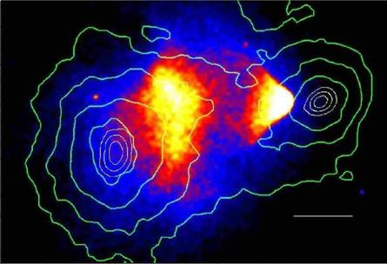
Bullet Cluster

Slide 24
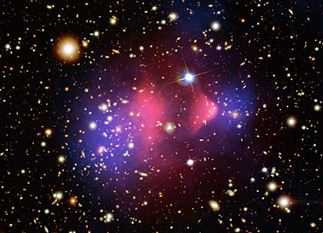
Bullet Cluster

Slide 25
DM content from clusters of galaxies
The observation of clusters of galaxies tends to give somewhat larger values, Ω_{DM} 0.2 to 0.3.
These observations include measurements of
the peculiar velocities of galaxies in the cluster, which are a measure of their potential energy if the cluster is virialized;
measurements of the X-ray temperature of hot gas in the cluster, which again correlates with the gravitational potential felt by the gas; and—most directly—
studies of (weak) gravitational lensing of background galaxies on the cluster.

Slide 26
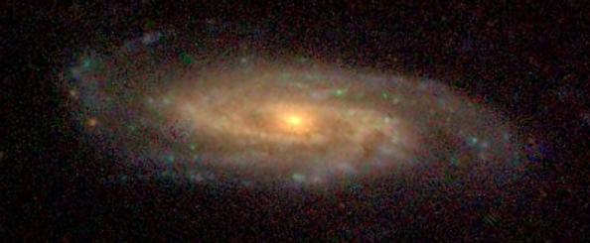
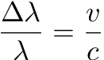
Rotation of Stars around Galactic Centres
We can measure how fast stars rotate around galactic
centres by looking at the frequency shift of known spectral
lines originating in the stars due to the Doppler effect.
Star’s motion towards you, relative to the
galactic centre alters wavelength of light

Slide 27
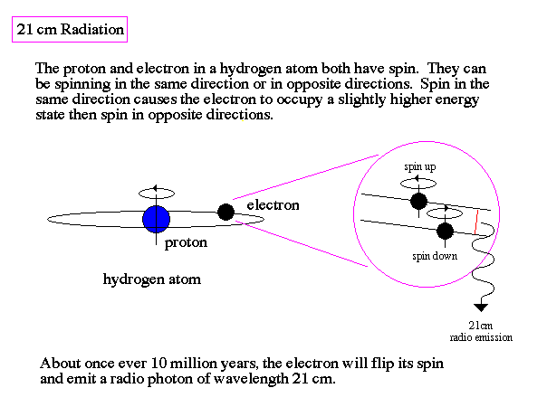
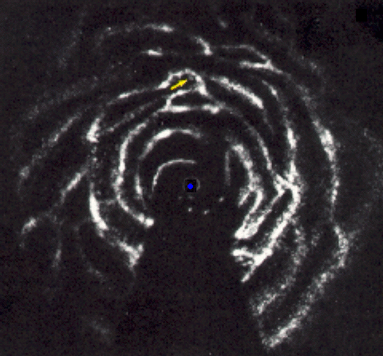
21 cm Radiation as Tracer of Gas Clouds
21 cm map of our Galaxy

Slide 28
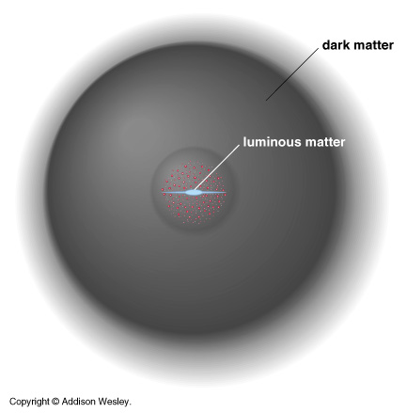
The Correct Way to Think about Our Galaxy

Slide 29
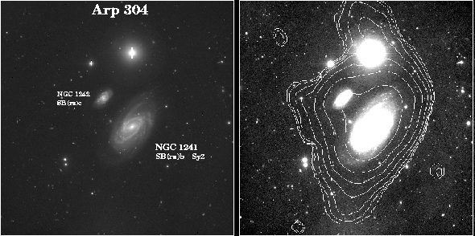
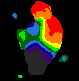
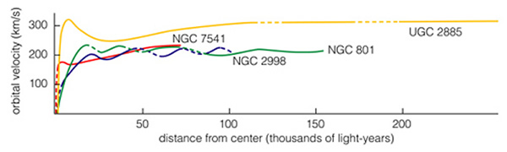

Slide 30
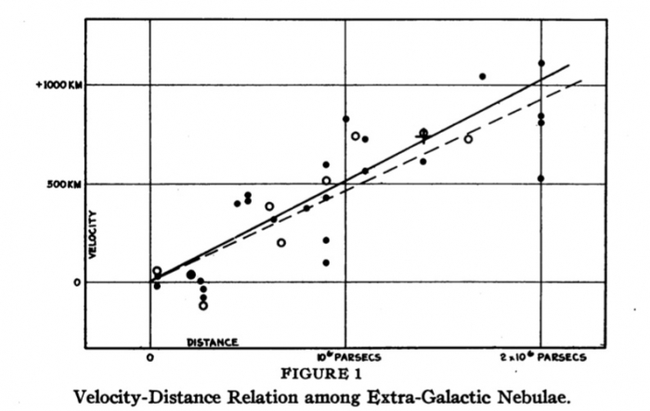
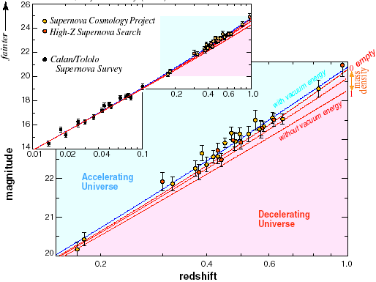
Recessional Velocities
The original evidence that the universe is expanding
Now carried out to far larger distances with supernovae
Constrains the acceleration of expansion:
Ω_{Λ} − Ω_{M}
“Attractive matter vs. repulsive dark energy”
Hubble (1929)

Slide 31
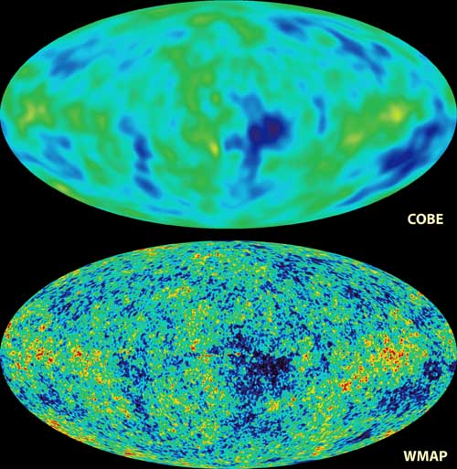
Cosmic Microwave Background
δT/T << 1: The universe is isotropic and homogeneous on large scales
Constrains the geometry of the universe:
Ω_{Λ} + Ω_{M}
“total energy density”

Slide 32
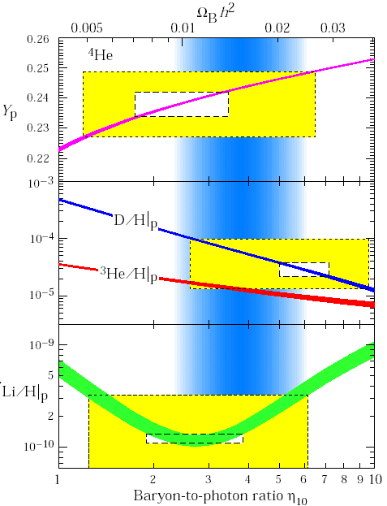
Big Bang Nucleosynthesis
At T ~ 1 MeV, the universe cooled enough for light elements to start forming
The abundance of each light species is fixed by η, the baryon-to-photon ratio
These determinations are consistent* and constrain (with the CMB) the density in baryons: Ω_{B}
Fields, Sarkar, PDG (2002)

Slide 33
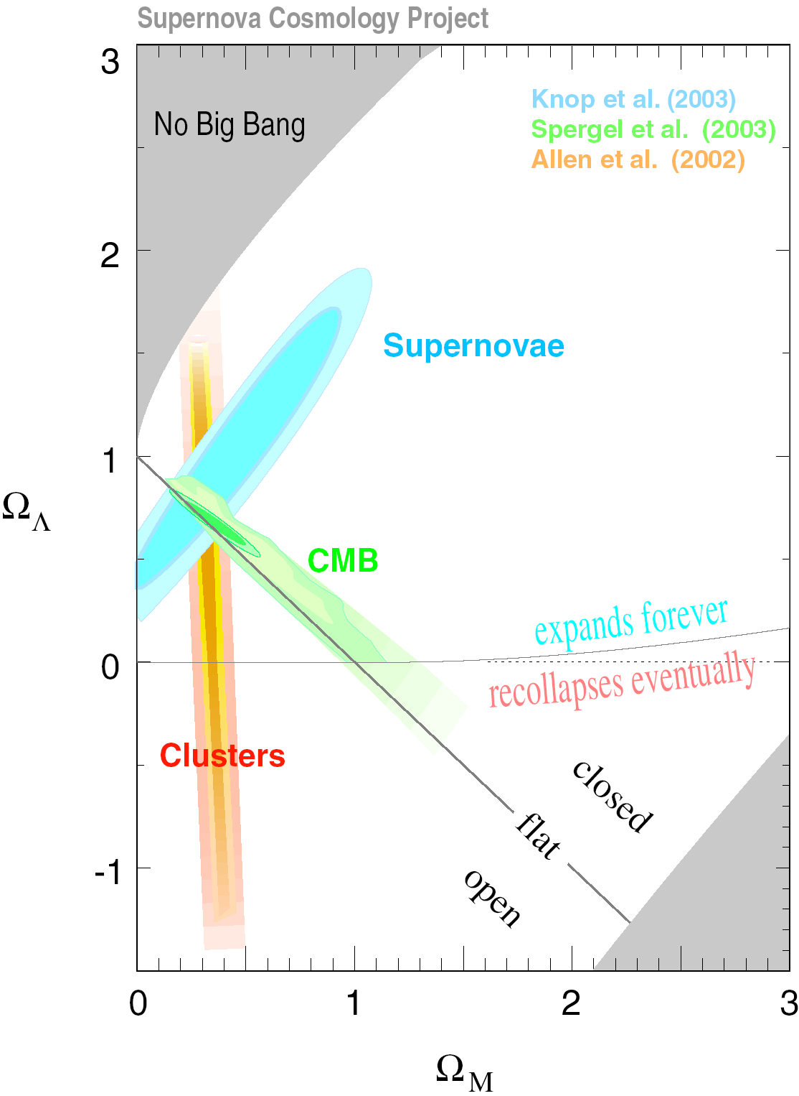
Synthesis
Remarkable agreement
Dark Matter: 23% ± 4%
Dark Energy: 73% ± 4%
Baryons: 4% ± 0.4%
[νs: 0.2% for Σm = 0.1 eV]
Remarkable precision (~10%)
Remarkable results

Slide 34
Question:
Is the mass in the universe all observable through
emmission or absorbsion of electromagnetic radiation ?
Dark Matter
...is matter that does not shine or absorb light, and has
therefore escaped direct detection by electromagnetic
transducers like telescopes, radio antennas, x-ray satellites...
It turns out that there is strong
experimental evidence that there is more
than 4 times as much dark matter as
luminous matter in the observable universe

Slide 35
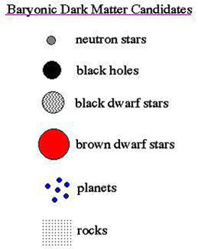
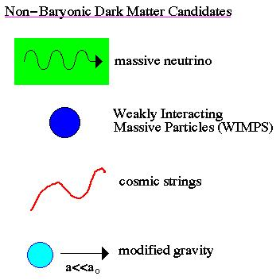
Possible Dark-Matter Candidates

Slide 36
What is it?
Dark Matter: Ordinary or Extraordinary?
What kind of ordinary matter is dark?
Black holes
Black dwarfs (cool white dwarfs)
Brown Dwarfs (failed stars)
Planets
Bowling Balls

Slide 37
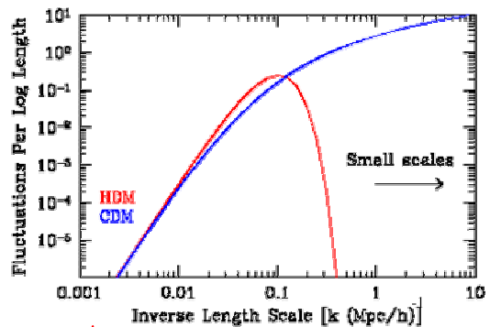
Nature of the dark matter—Hot or cold
Hot dark matter is relativistic at the collapse epoch and free-streaming out the galaxy-sized over density. Larger structure forms early and fragments to smaller ones.
Cold DM is non-relativistic
at de-coupling, forms
structure in a hierarchical,
bottom-up scenario.
HDM is tightly bound from
observation and LSS forma-
tion theory

Slide 38
What we learned
In the universe there exists non-baryonic, non-hot, dark matter

Slide 39
What Could Constitute the Dark Matter (1)?
IDEA 1 : Rocks
from pebbles to giant planets like Jupiter.
If there are enough of them, they could make
up the dark matter.
Jupiter-size and above planets are a serious contender,
and are called MACHOs by the community - MAssive
Compact Halo Objects.
IDEA 2: Neutrinos
Light, neutral particles of which at least some have a small
mass. Produced in enormous numbers in stars and possibly
at the big bang. If there are enough of them, they could
(maybe) be the dark matter.

Slide 40
What Could Constitute the Dark Matter (2) ?
IDEA 3: Black Holes
Don’t emit significant amounts of light, can be
very massive. Would need lots of them.
IDEA 4: Cosmic Strings
Dense filamentary structures that some theorists think
could thread the universe, giving rise to its present-
day lumpiness. Currently disfavoured by cosmological data,
but may come back into vogue sometime.

Slide 41
What Could Constitute the Dark Matter (3) ?
IDEA 5: Axions
Very light particles, mass around 1/1,000,000,000,000
of an electron. Needed for building most realistic models
of the neutron from standard model particle physics. Not
detected. To be the dark matter, there should be around
10,000,000,000,000 per cubic centimetre here on Earth.
IDEA 6: WIMPS (for the rest of this talk)
Particles having mass roughly that of an atomic nucleus,
could be as light as carbon or as heavy as 7 nuclei of xenon.
Need a few per litre to constitute dark matter. Unlike nucleus,
only interact WEAKLY with other matter, through the same
mechanism that is responsible for nuclear beta-decay.

Slide 42
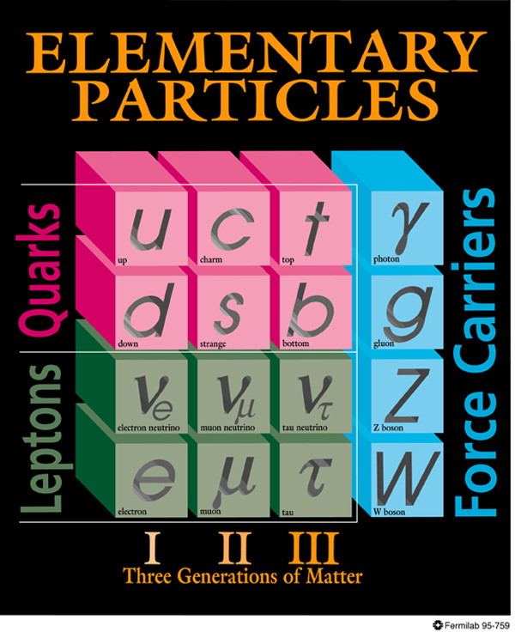
DARK MATTER
Known DM properties
Gravitationally interacting
Not short-lived
Not hot
Not baryonic
Unambiguous evidence for new particles

Slide 43
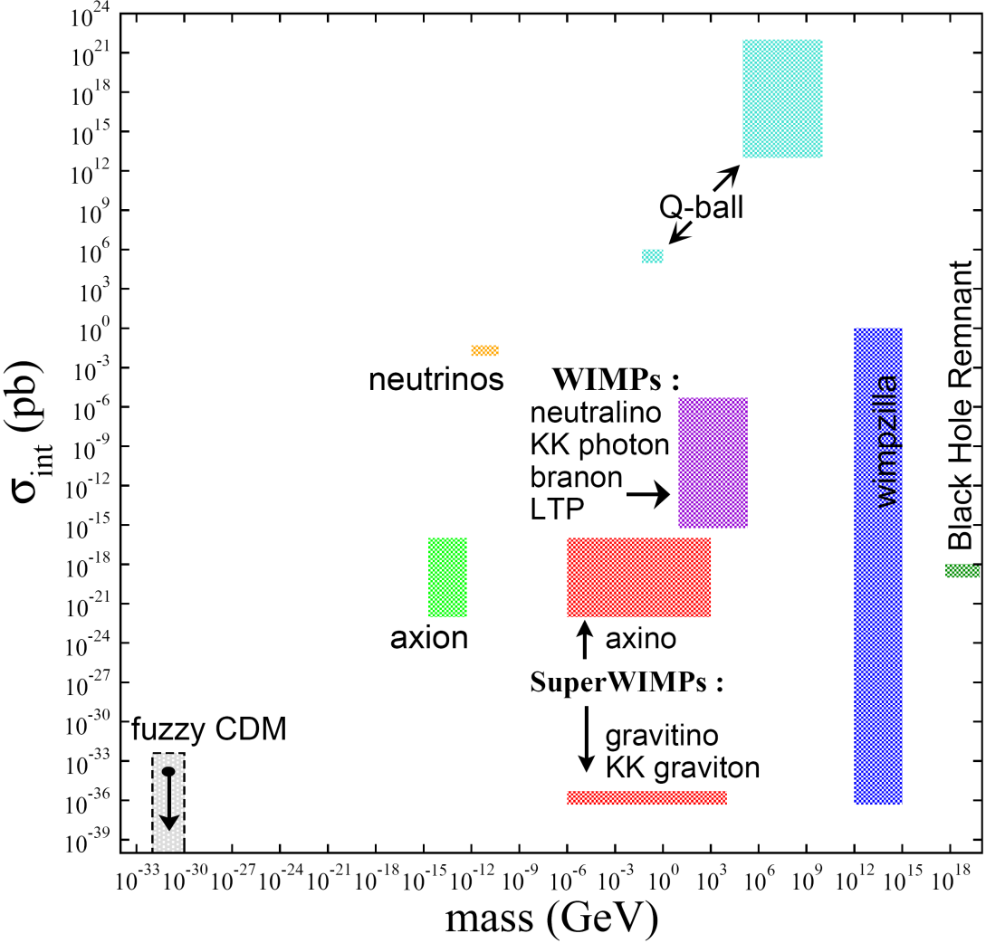
DARK MATTER CANDIDATES
There are many
Masses and interaction strengths span many, many orders of magnitude, but the gauge hierarchy problem especially motivates Terascale masses
HEPAP/AAAC DMSAG Subpanel (2007)

Slide 44
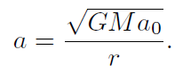
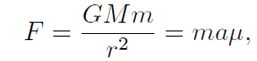
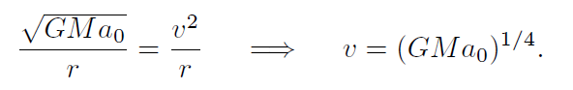
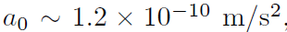
MOND
In 1983, Milgrom proposed a modified Newtonian dynamics in which F=ma is modified to F=maµ, which µ is 1 for large acceleration, becomes a/a0 when a is small.
To explain the rotational curve, one can choose

Slide 45
Problems with MOND
Cannot fit into a framework consistent with GR.
Hard to describe the expansion history, therefore the CMB fluctuation and galaxy distribution.
Hard to explain the bullet cluster.
No MOND can explain all gravitational anomalies without introducing DM.

Slide 46
From particle physics
WIMP(Weakly interacting massive particles)
is a natural dark matter candidate giving correct relic density

Slide 47
Dark Matter Content
The currently most accurate determination of Ω_{DM} comes from global fits of cosmological parameters to a variety of observations: the anisotropy of CMB and of the spatial distribution of galaxies, one finds a density of cold, non–baryonic matter
Ω_{nbm}h² = 0.106 ± 0.008
where h is the Hubble constant in units of 100 km/(s·Mpc).
Some part of the baryonic matter density,
Ω_{b}h² = 0.022 ± 0.001
may well contribute to (baryonic) DM, e.g., MACHOs or cold molecular gas clouds

Slide 48
Matter Formation in the Big Bang
Start with hot dense “soup” of elementary particles and radiation
Expand, cool, “freeze out”
Predictions for light element abundance
Cosmic microwave background
Strict upper bound on baryon content
Evidence for non-baryonic dark matter

Slide 49
Agreement on the Numbers:
Gravitational Lensing provides additional graphic evidence for dark matter
All techniques converge:
3% luminous conventional matter
14% dark conventional matter
83% non-baryonic dark matter

Slide 50
WIMP hypothesis
Weakly Interacting Massive Particle
WIMPs freeze out early as the universe expands and cools
WIMP density at freeze-out is determined by the strength σ_{x} of the WIMP interaction with normal matter
Leads to σ_{x} ~ σ_{weak interaction}

Slide 51
What we DO NOT know…
The WIMP mass Mx
prejudice 10<Mx<10000 Gev/c²
The WIMP Interaction Cross-Section
Prejudice σ∼σ_{weak}
(give or take several orders or magnitude…)
The nature of the interaction
Spin coupling?
Atomic Number coupling?

Slide 52
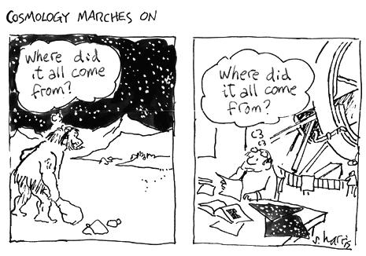
earth, air,
fire, water
baryons, νs,
dark matter,
dark energy
We live in interesting times: we know how much there is, but we have no idea what it is
Precise, unambiguous evidence for new particle physics

Slide 53
Dark Matter Production
2.1. Thermal Production
WIMPs and many other dark matter candidates are in thermal equilibrium in the early universe and decouple once their interactions become too weak to keep them in equilibrium. Those particles are called thermal relics

Slide 54
As their density today is determined by the thermal equilibrium of the early universe. When the annihilation processes of WIMPs into SM parti- cles and vice versa happend at equal rates, there is a equilibrium abundance.

Slide 55
When the Universe cooled down and the rate of expansion of the universe H exceeds the annihilation rate, the WIMPs effectively decouple from the remaining SM particles.So the equilibrium abundance drops exponentially until the freeze-out point.The abundance of cosmological relics remained almost constant until today.

Slide 56
Calculations
Now we will see how the calculation of the relic density of WIMPs proceeds within the standard cosmological scenario.

Slide 57
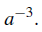
If the candidate is stable or has a long lifetime, the number of particles is conserved after it decouples, so the number density falls like Specifically, we use the Lee-Weinberg Equation. It describes annihilation and creation of χ particles.

Slide 58
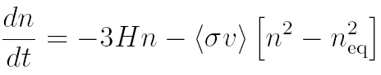
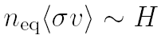
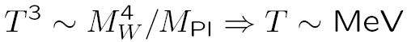
DECOUPLING
Decoupling of particle species is an essential concept for particle cosmology. It is described by the Boltzmann equation
Particles decouple (or freeze out) when
An example: neutrino decoupling. By dimensional analysis,
Dilution from
expansion
‾
‾
XX → f f
f f → XX

Slide 59



: the equilibrium number density of the relic particles
3Hnχ: the effect of the expansion of the universe
< σv > :the thermal average of the annihilation cross section σ multiplied with the relative velocity v of the two annihilating χ particles
other term on RHS is the decrease (increase) of the number density due to annihilation into (production from) lighter particles

Slide 60



The Lee-Weinberg equation assumes that χ is in kinetic equilibrium with the standard model particles
Now we use the effect of the expansion of the Universe by considering the evolution of the number of particles in a portion of comoving volume given by
We can then introduce the convenient quantity
such that

Slide 61

In addition, since the interaction term usually depend explicitly upon temperature rather than time, we introduce the x = m/T , the scaled inverse temperature.
During the radiation dominated period of the universe, thermal production of WIMPs takes also place . In this period, the expansion rate is given by

Slide 62


And then
Where and where denotes the number of
intrinsic degrees of freedom for particle.

Slide 63


Hence , last format of our equation is
where

Slide 64


After all little tricks , our Lee-Weinberg equation can be recast as
where

Slide 65

To integrate the Lee-Weinberg equation, we need to have an expression for the equilibrium number density in comoving volume.
Once the particle is non-relativistic, the difference in statics is not important.
The general equation of equilibrium number density in comoving volume is

Slide 66

For the nonrelativistic case at low temperatures T << mχ one obtains,

Slide 67
At high temperatures, χ are abundant and rapidly annihilate with its own antiparticle χ into the standard model particles.
Shortly after that T has dropped below mχ(T << mχ) ,the number density of χ drops exponentially, until the annihilation rate
Γχ =N(x) < σv > becomes less than the expansion rate H

Slide 68
The temperature at which the particle decouples (The time when the number of particles reaches this constant value) from the thermal bath is called freeze-out temperature TF .
Therefore χ particles are no longer able to annihilate efficiently and the number density per comoving volume becomes almost constant.

Slide 69






An approximate solution for the relic abundance is given by
and is freeze-out temperature and approximately, for the typical case
One has that is a solution of

Slide 70


We can then finally calculate the contribution of χ to the energy density parameter finding a well know result
It is intriguing that so called "WIMPS"(e.g. the lightest supersymmetric particle) dark matter particles seem to reproduce naturally the right abundance since they have a weak cross section

Slide 71
,and masses mx mew 100GeV .
This observations is called the "WIMP miracle" and typically considered as an encouraging point supporting WIMPS as Dark Matter candidates.

Slide 72


1) Initially, neutralinos χ are in thermal equilibrium:
χχ ↔‾ f f
2) Universe cools:
N = N_{EQ} ~ e ^{−m/T}
3) χs “freeze out”:
N ~ constant
Freeze out determined by annihilation cross section: for neutralinos, Ω_{DM} ~ 0.1; natural – no new scales!

Slide 73
Lee-Weinberg equation, the termal production, is the most traditional mechanism but that many other mechanisms have been considered in the literature such as non thermal produc- tion of very massive particles(so called WIMPZILLAS) at preheating or even right-handed neutrino oscillations.

Slide 74
Detection Promising
χ
χ
χ
f
Crossing
symmetry
χ
‾ f
f
‾ f
Annihilation
Scattering
Correct relic density → efficient annihilation then
→ efficient annihilation now, efficient scattering now
No-Lose Theorem

Slide 75

Assume gravitino is LSP. Early universe behaves as usual, WIMP freezes out with desired thermal relic density
A year passes…then all WIMPs decay to gravitinos
WIMP
M*²/M_{W}³ ~ year
≈
G̃
Gravitinos are dark matter now. They are superWIMPs –
superweakly-interacting massive particles

Slide 76

Title
Inner space and
outer space
are closely related

Slide 77

FREEZE OUT: QUALITATIVE
(1) Assume a new heavy particle X is initially in thermal equilibrium:
XX ↔‾ qq
(2) Universe cools:
XX ‾ qq
(3) Universe expands:
XX ‾ qq
(1)
Increasing
annihilation
strength
↓
(2)
←
(3)
/
→
→
/
←
/
Feng, ARAA (2010)
Zeldovich et al. (1960s)

Slide 78
WIMP EXAMPLES
Weakly-interacting massive particles: many examples, broadly similar, but different in detail
The prototypical WIMP: neutralinos in supersymmetry
_{Goldberg (1983)}
KK B¹ (“KK photons”) in universal extra dimensions
Servant, Tait (2002); Cheng, Feng, Matchev (2002)
Cosmology and particle physics both point to the Terascale for new particles, with viable WIMP candidates from SUSY, UED, etc.

Slide 79
WIMP DETECTION
Correct relic density → Efficient annihilation then
χ
χ
Efficient production now
(Particle colliders)
Efficient annihilation now
(Indirect detection)
q
q
Efficient scattering now
(Direct detection)

Slide 80
DIRECT DETECTION
Look for normal matter recoiling from DM collisions
WIMP properties
m ~ 100 GeV
velocity ~ 10⁻³ c
Recoil energy ~ 1-100 keV
Typically focus on ultra-sensitive detectors placed deep underground
But first, what range of interaction strengths are to be probed?
DM

Slide 81
Indirect Detection
Dark Matter Madlibs!
Dark matter annihilates in ________________ to
a place
__________ , which are detected by _____________ .
particles an experiment

Slide 82



INDIRECT DETECTION
Dark Matter annihilates in to
a place
, which are detected by .
some particles an experiment
the halo
positrons
PAMELA/ATIC/Fermi…
PAMELA
ATIC
Fermi

Slide 83


Dark Matter annihilates in the center of the Sun to
a place
neutrinos , which are detected by IceCube .
some particles an experiment

Slide 84


Dark Matter annihilates in the galactic center to
a place
photons , which are detected by Fermi, VERITAS, … .
some particles an experiment
Lines from XX → γγ, γZ
Continuum from XX → ff → γ
Particle
Physics
Astro-
Physics
Halo profiles are poorly understood near the galactic center

Slide 85

PARTICLE COLLIDERS

Slide 86

DIRECT PRODUCTION at colliders
Thermal relic WIMPs annihilate to SM particles, and so should be produced directly at colliders
Pair production is invisible, so consider photon radiation
Also mono-jets, mono-photons at Tevatron and LHC
Birkedal, Matchev, Perelstein (2004); Feng, Su, Takayama (2005)
Konar, Kong, Matchev, Perelstein (2009)

Slide 87


PRECISION DM AT COLLIDERS
If there is a signal, what do we learn?
Cosmology can’t discover SUSY
Particle colliders can’t discover DM
Lifetime > 10 ⁻⁷ s → 10¹⁷ s ?

Slide 88

DARK MATTER AT THE LHC
What LHC actually sees:
E.g., q̃q̃ pair production
Each q̃ → neutralino χ
2 χ’s escape detector
missing momentum
This is not the discovery of dark matter
Lifetime > 10⁻⁷ s → 10¹⁷ s?

Slide 89
DARK MATTER ANALOGUE
Particle physics → dark matter abundance prediction
Compare to dark matter abundance observation
How well can we do?

Slide 90
SUMMARY
Thermal relic WIMPs can be detected directly, indirectly, and at colliders, and the thermal relic density implies significant rates
There are currently tantalizing anomalies
Definitive dark matter detection and understanding will require signals in several types of experiments

Slide 91
Next time
f(R) Gravity and its relation to the interaction between DE and DM

